Slide 1
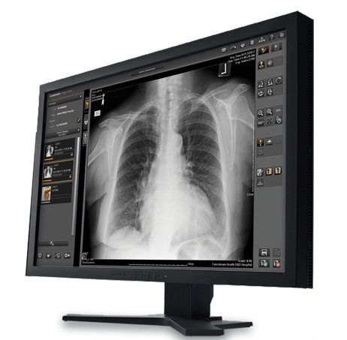
Image Suite / V4 Software
Simple. Affordable. Powerful.

Slide 2
Image Suite / V4 – A Perfect Software Solution
A Complete Digital Image Acquisition and Optional Archive Solution
Simple
Quickly and easily acquire, process, edit and send images for storage or printing
Simple to install and training can be completed in less than a day
Affordable
Created for private practices and smaller clinics to offer an economical CR & DR Acquisition and PACS solution
Powerful
All in one system with superior image processing
Flexible
Easily customized to meet your specific business needs
Get the features you need now, and add capabilities in the future as your practice grows

Slide 3
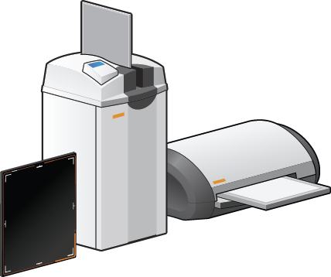
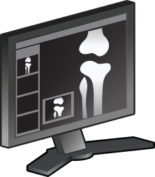
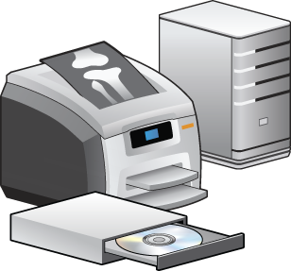
Streamline Your Workflow
Schedule
Acquire
View/Edit
Diagnosis/Report
Print/Archive
All at an Affordable Price

Slide 4
Schedule
Accelerate the Registration Process – From Anywhere
Register patients remotely with Web-based software
Selection graphics allow for quick and easy picking of the body parts and views
Add new body parts and views, edit existing ones or apply custom processing
Connect with DICOM Modality Worklist or HL7 Compliant EMR/RIS systems for a simplified registration

Slide 5
Acquire
Touch friendly user inCapture High-quality Images Quickly and Easily by Pairing Image Suite with Carestream CR Systems
Interface allows simple navigation for an enhanced user experience
Count on consistent image quality with Enhanced Visualization Image Processing (EVP+)
Clinical tools and applications including circular masking, histogram, ROI analysis, reject analysis and more
Reference positioning images and sample X-ray image guides can improve image quality and accelerate workflow
Option to automatically acquire DAP and technique information eliminating the need for manual entry*
*Contact Carestream to see if a specific generator/DAP is supported

Slide 6
View/Edit
Obtain High-quality Images
Improve workflow and productivity with a simple, easy-to-use acquisition screen
Utilize up to 8 concurrent web viewer sessions (Archive includes 4 Web CLs)
Access patient images and reports anywhere with the Tablet Viewer on an iPad
Specialized measurement tools for Chiropractic and Orthopedic
Automatic and Manual Stitch Editors allow you to manipulate and paste individual images together (now standard with system)*
Fine-tune image processing using simple slide bars to adjust brightness, contrast, and sharpness
Access full bit-depth images at host workstation
Customize your image orientation with an arbitrary rotation tool
*Automatic stitching for CR Portable LLI Cassette Only
Notes:
Supports 8 concurrent web viewer sessions for increased flexibility
Image processing can be tuned with the click of a button, using simple slide bars to adjust brightness, contrast or detail
Delivers full bit-depth images at the host workstation
Advanced measurement tools for chiropractic review
Supports high resolution acquisition, review and printing of mammography images (outside US)

Slide 7
Advanced Measurement Tools
Image Suite V4 Chiropractic Tools Include
• Gonstead Measurement Tool • Cervical Curve Measurement Tool • Lumbar Curve Measurement Tool • Measure from Vertical Tool • Measure form Horizontal Tool • Vertical Axis Line Tool • Line Extension Tool • George's Line Tool • Goniometry Measurement Tool • Coxometry Measurement Tool
• Offset Cobb Angle • Extended Cobb Angle • Mark Spot
Line Ratio • Vertical Deflection • Horizontal Deflection • Absolute Rotation Angle • Vertebral Compression • Center Mass with Atlas Plane • Logan Basic Marking
*Automatic stitching for CR Portable LLI Cassette Only
Notes:
Supports 8 concurrent web viewer sessions for increased flexibility
Image processing can be tuned with the click of a button, using simple slide bars to adjust brightness, contrast or detail
Delivers full bit-depth images at the host workstation
Advanced measurement tools for chiropractic review
Supports high resolution acquisition, review and printing of mammography images (outside US)

Slide 8
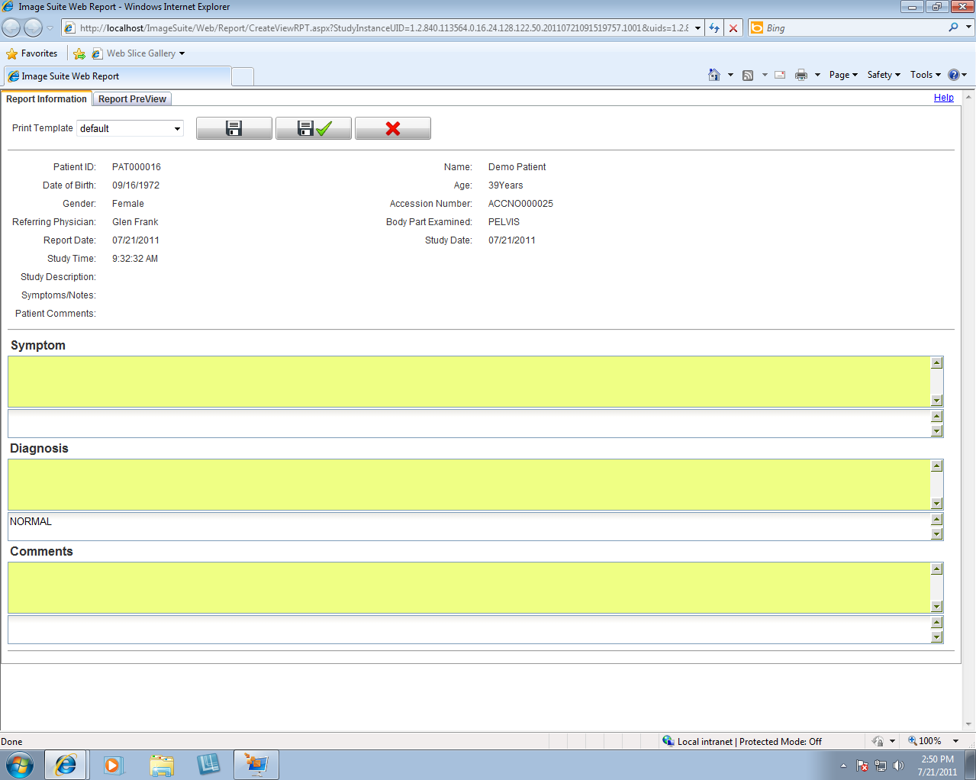
Diagnosis/Report
Speed Diagnoses, Improve Patient Care
Boost productivity by viewing multiple images simultaneously via dual-monitor support on Web clients
Receive images from CT, MR, Ultrasound and additional CRs/DRs with optional DICOM store SCP
Generate and review reports on multiple web clients throughout your facility
Perform system quality testing with the CR Total Quality Tool software (now standard with system)
Safely transfer DICOM images over the Internet without the necessity of VPN or encrypted tunnel connections using the OmniLink software - ideal for mobile applications
Notes:
Ability to created/edited/reviewed/printed at workstation and web client offers flexibility for radiologists
Dual monitor support on Web clients enables increased efficiency by allowing the viewing of multiple images at once
Process full bit-depth (raw/full-fidelity) images at the host workstation, including ability to control brightness, latitude, contrast, sharpness and noise
Receive images from CT, MR, ultrasound and additional CRs with the optional DICOM store SCP software

Slide 9
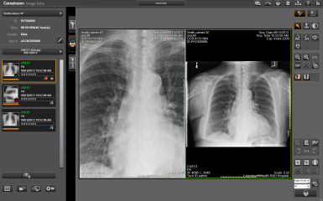
Print/Archive
Share and Store Images Efficiently
Maximize security with on-demand or scheduled backup
Perform backups to CDs, NAS or removable USBs for off-line storage
Optimize usability of images with JPEG or DICOM export tools
Perform multi-format print composition with independent image-editing capabilities
Notes:
Flexible security with on-demand or scheduled backup
Storage of both “for processing & for presentation” images gives you the most flexibility for reprocessing stored images – both simple and advanced adjustments – unlike any other PACS
Perform backups to CDs and removable USBs on demand for off-line storage
Usability of images for remote reporting with JPEG or DICOM export tools
Support multi-format print composition with independent image editing capability

Slide 10
Available Options
Mini-PACS Archiving Software
Tablet Viewer
Web Viewer License(s)
Long-Length Imaging Cassette/Wallstand/Caddy
DICOM Store Service Class Provider (SCP)
CR TQT Phantom
Clinical Report Software
Mammography Feature Software (Outside USA)
Web Appointment Multiple Instance License
* FDA 510(k) Clearance

Slide 11
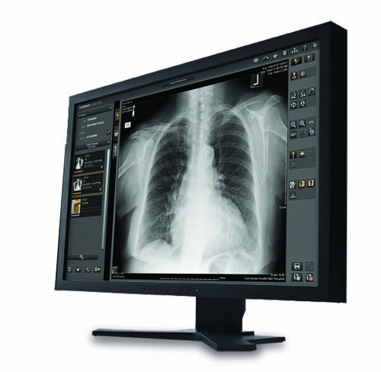
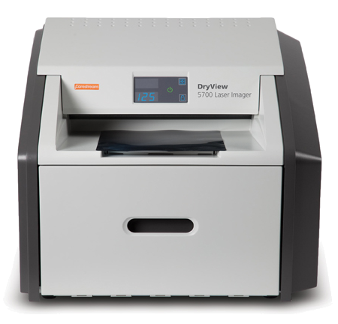
Carestream’s Perfect Companions
Image Suite
Vita CR Scanners
DryView Printers

Slide 12
Summary
Image Suite is an Acquisition Software with an Optional Mini-PACs solution
All-in-one software that is Simple to use, Affordable, Powerful and Flexible with a number of tools to increase workflow efficiency
Designed for Small Clinics or Private Practices
General radiology (including mammography Outside US)
Chiropractic medicine
Perfect bundle with the Carestream’s CR Scanners and DryView Printers
Simple. Affordable. Powerful.

